Slide 1

Creating Custom Interactive Applications with R and Shiny
Chris Runyon, Josh Goodman,
and Marcus Walker
Day 2

Slide 2
Welcome back!
Day 1: Covered the basics of a Shiny app.
Today’s Agenda:
End of Day 1
Deployment
UI Organization, useful Shiny extensions
App Development Exercise - Unifying Day 1 and New Content
Shiny App Examples
Additional Shiny Resources
Notes:
First half of today is all about implementation. On Friday we helped you learn some of the constituent parts of Shiny so it’s not so new when you embark on creating a Shiny app. Today we’re going to do just that - we’re going to walk through a mock “assignment” to (1) show one way to plan out a Shiny app; and (2) implement some of the things that you’ve learned on Day 1.
After getting our app together for our team, we’ll take a 15 minute break. This will be the end of the hands-on activities for the workshop.
The second half of today is going to be a series of short info sessions designed to help you in the next steps of continuing to learn Shiny. These “info” sessions are going to be at all levels - beginning, intermediate, and more advanced. Our intent in doing these info sessions to help you get a little farther than just googling these topics - you can come back to the workshop materials and find a curated list of resources to help you start learning the next Shiny thing that you want to know, and then you can continue from there.

Slide 3
Day 2 Learning Objectives
Will be able to identify R packages that significantly extend the functionality of Shiny apps.
Will have be able to identify some of the necessary considerations for developing a Shiny app.
Will be able to identify sources for learning more on a wide variety of Shiny-related topics.

Slide 4
Back to Josh!

Slide 5
Deployment - shiny.rstudio.com/deploy/ ; book chapter
Laptop / Desktop
Local Server / Shiny Server Open Source
Shinyapps.io
RInno / electron

Slide 6
Laptop / Desktop
Advantages
Disadvantages
Fast and Easy
No additional costs
Limited functionality / reach
Limited access
What data does your app depend on?
Security considerations

Slide 7
Local Server - shiny-server
Advantages
Disadvantages
Open Source / Free
Can be deployed behind firewalls
Allows access to all individuals that can locate the app
Doesn’t need to be on their desktop
Will involve some IT / developer engagement
May be an associated cost
May still have some of the same data/security issues, depending on how the app is set up
RStudio Connect ($)

Slide 8
Shinyapps.io Deployment
Advantages
Disadvantages
Easy to set up and deploy your app online.
Free and lower-cost tiers are relatively inexpensive
Additional support / features at higher-cost tiers
Increased access, no (or little) additional help necessary to host the app.
Ongoing cost; long-term considerations.
Security / data issues may still be present.
RStudio Connect can mitigate some of these.

Slide 9
RInno / similar packages (DesktopDeployR ?) (electricShine ?)
Advantages
Disadvantages*
Completely stand-alone version of the Shiny app
Possible use without a connection to the internet
Very fragile
Size of .exe can be large depending on what packages are also included
Can be difficult to troubleshoot / debug
*Disclaimer: Based on when Chris used RInno 3 years ago. We’d love to hear your success stories with this!

Slide 10
More UI Layouts / Organization!

Slide 11
UI Organization (continued)
fluidPage, fluidRow, etc.
Multiple displays with tabs
Dashboards
Combination of the above

Slide 12
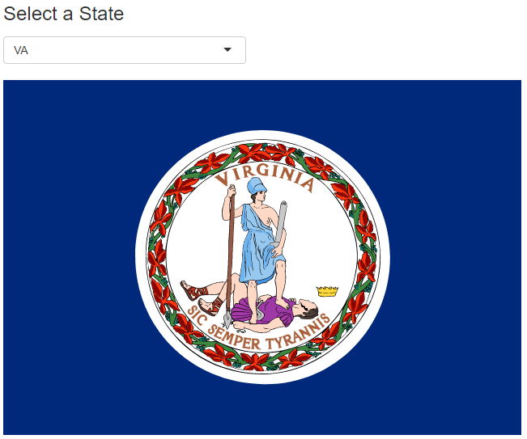
Single Display (PickState.R)

Slide 13
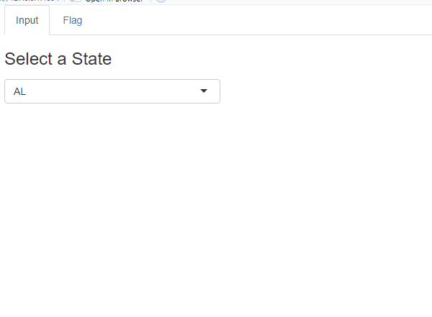
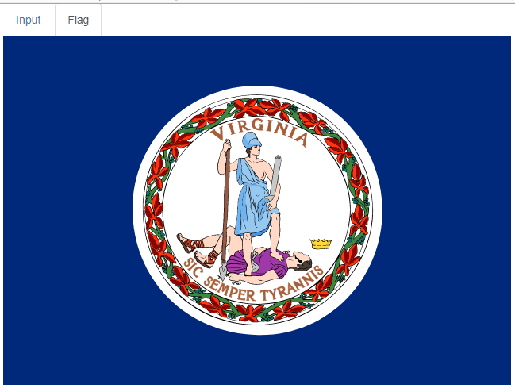
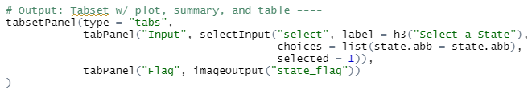
Tab Display (PickStateTab.R)

Slide 14
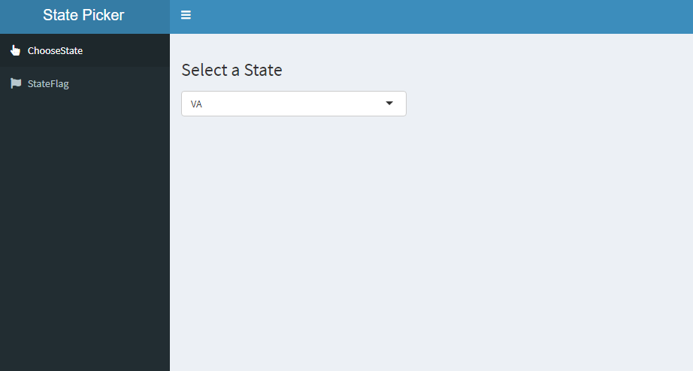
Dashboard Display (PickStateDash.R)

Slide 15
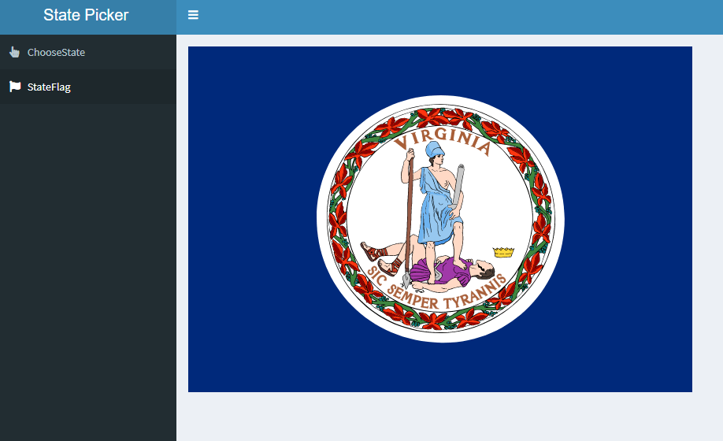
Dashboard Display (PickStateDash.R)

Slide 16
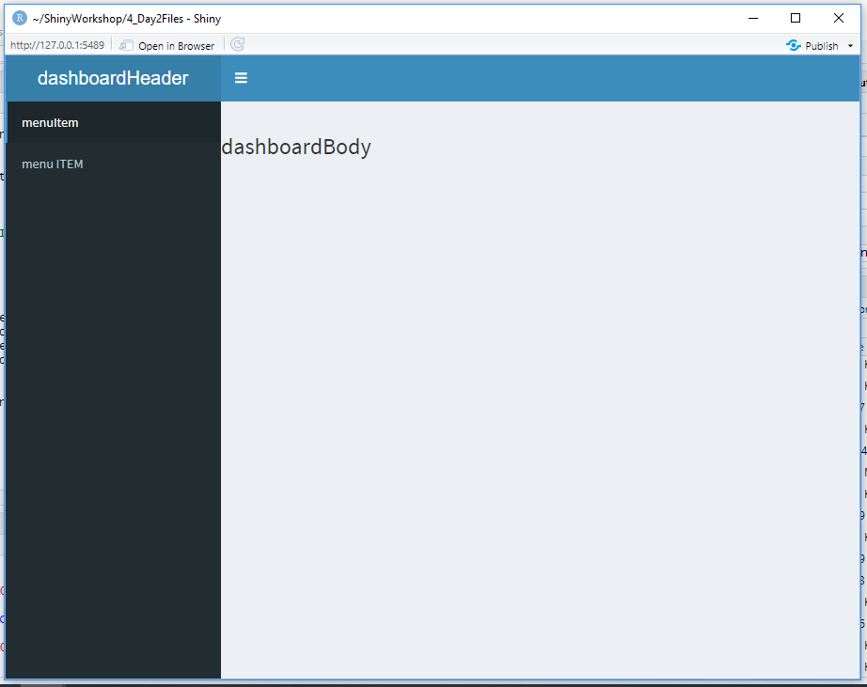
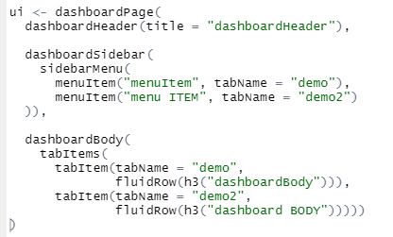
Dashboard Displays (dashComponents.R)

Slide 17
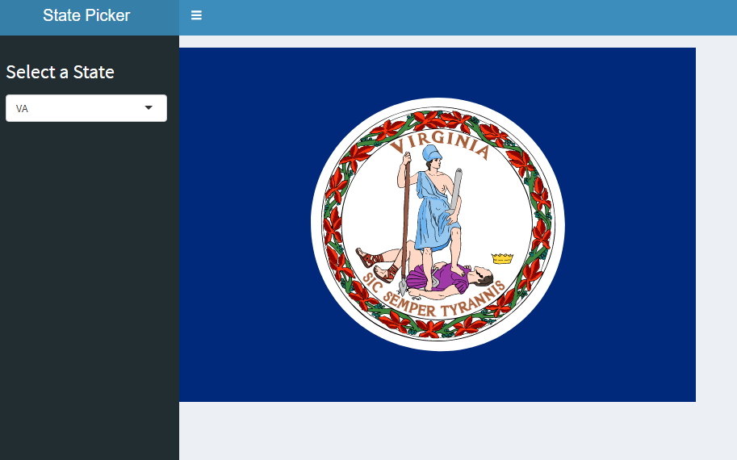
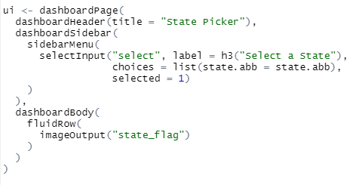
Dashboard Display (PickStateDash2.R)
Notes:
Side of the Dashboard is used as input!

Slide 18
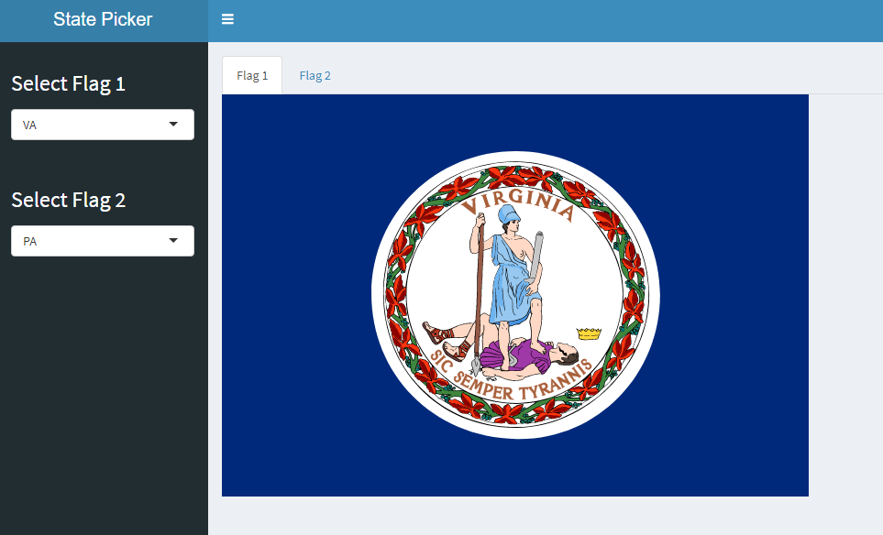
Dashboard Display (PickStateDash3.R)

Slide 19
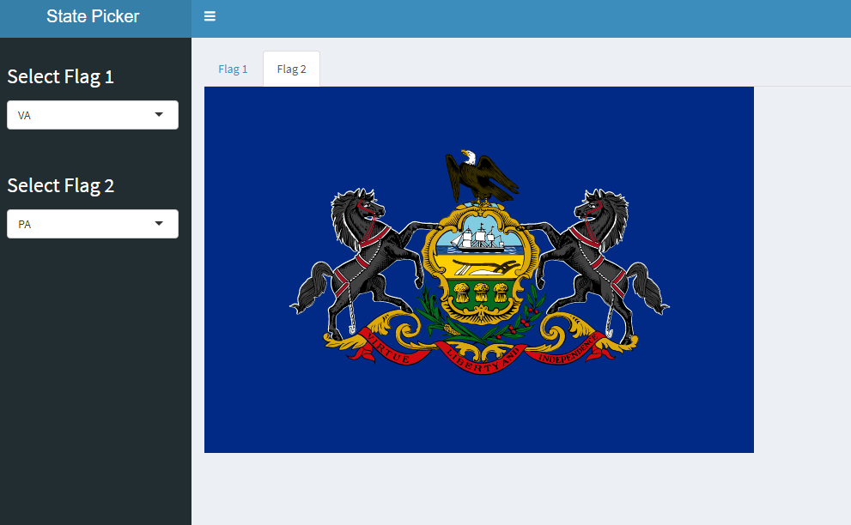
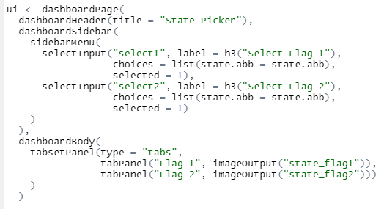
Dashboard Display (PickStateDash3.R)

Slide 20
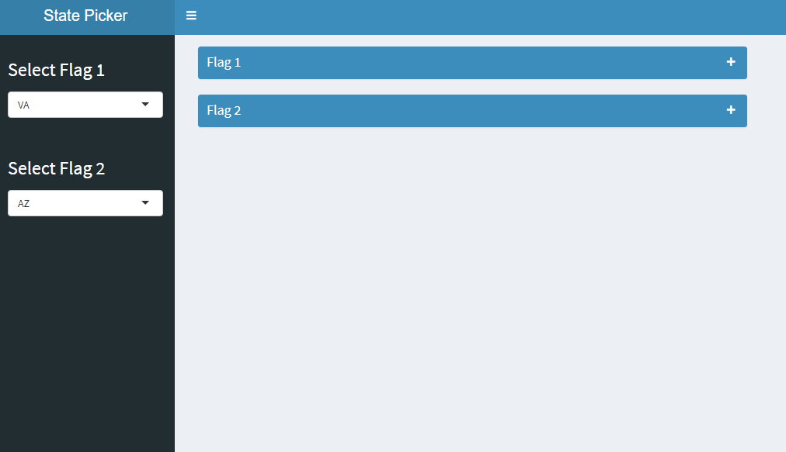
Dashboard Display (PickStateDash4.R)

Slide 21
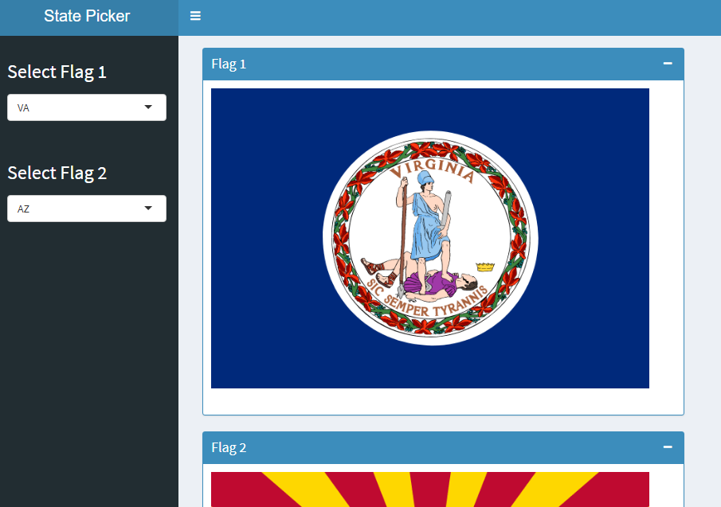
Dashboard Display (PickStateDash4.R)

Slide 22
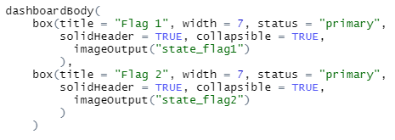
Dashboard Display (PickStateDash4.R)

Slide 23
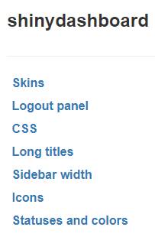
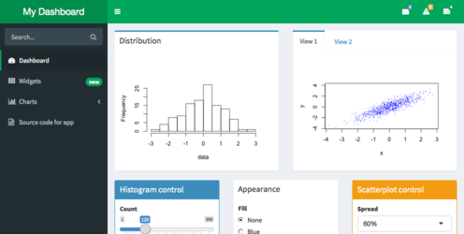
Shinydashboard Themes (“Appearance”)

Slide 24
Extending Shiny functionality with packages

Slide 25
Dynamic Table and Plots
A number of packages have been developed that leverage HTML / CCS / JavaScript to make dynamic tables and charts in Shiny app (and R Markdown HTML files)
DT (“data tables”) is a popular package for dynamic tables
plotly is a popular framework for dynamic plots

Slide 26
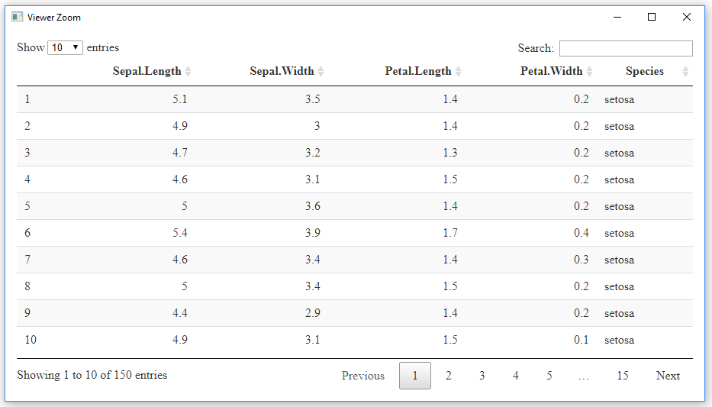
DT (DTdemo.R)
library(DT)
datatable(iris)

Slide 27
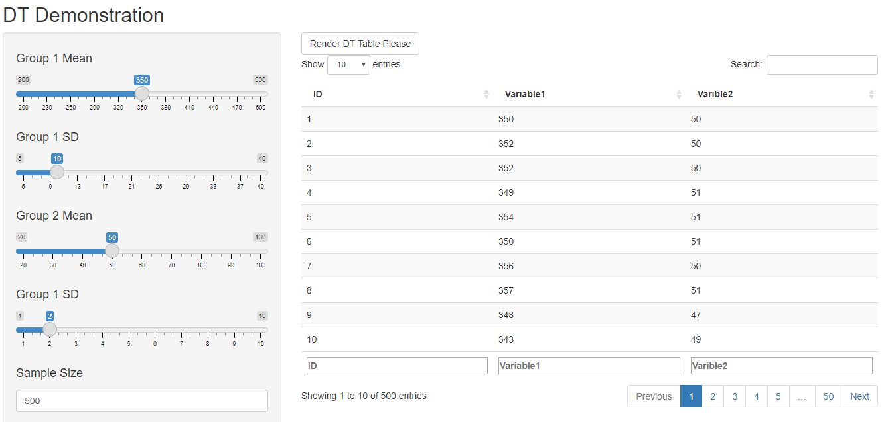
DT (DTshiny.R)

Slide 28
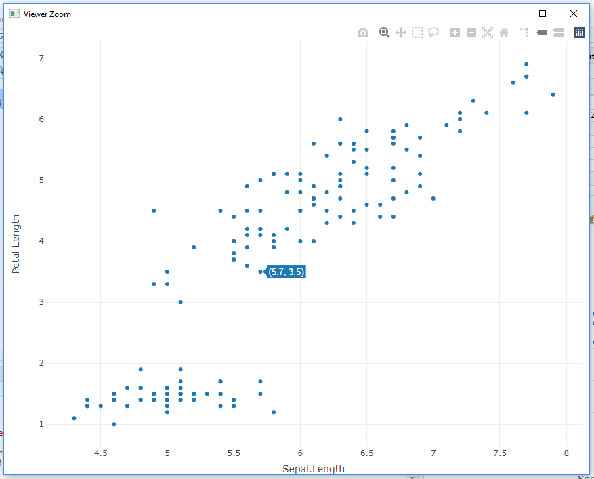
Plotly (plotlydemo.R)
library(plotly)
fig <- plot_ly(data = iris, . x = ~Sepal.Length, . y = ~Petal.Length)
fig

Slide 29

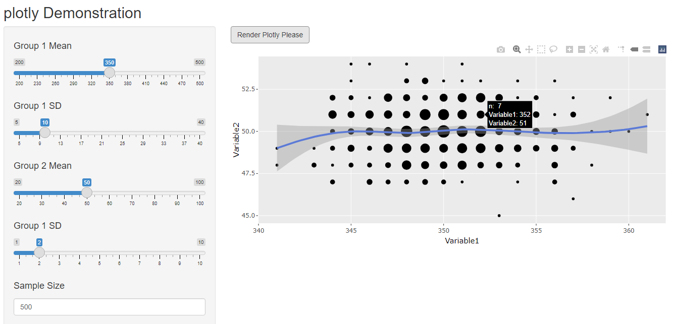
Plotly (plotlyshiny.R)

Slide 30
shinyjs
shinyjs is a really nice simple package that uses JavaScript to add some interesting functionality to your UI. With it, you can do such things as:
Hide, show, or toggle elements
Disable / enable inputs
Delay code execution
Include a reset button
Code and call your own JavaScript functions
Link to demo

Slide 31
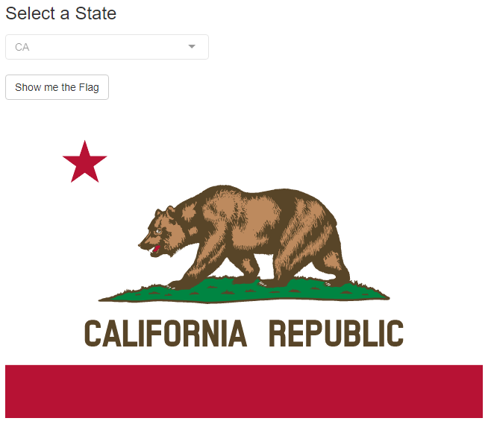
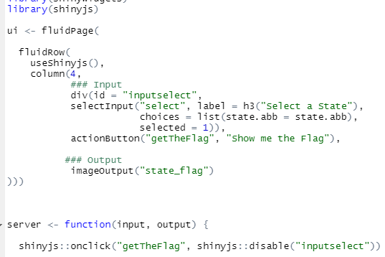
PickStateObsEvent.R

Slide 32
Break / Assignment:
Build a Shiny app!

Slide 33
Build a Shiny App!
Some considerations:
What input methods would be best for this purpose? What options are most appropriate for this audience?
What outputs would be best for this purpose? What type of information would be easy to understand?
How will you separate the information for the general public from the information for a technical report?

Slide 34
Break / Assignment
Build a Shiny app!
Must use shinydashboard, plotly, and DT
Cannot use built-in datasets
Generate data based on some inputs (Josh and I both have DGMs in our code)
Read in the sampleDataset.csv (fileInput())
Two different input types
Stylize at least 1 element - color, font, the icon for menuItem, etc.
Stretch goal: Include a shinyjs() element

Slide 35
Break / Assignment
4_solution1.R
4_solution2.R

Slide 36
Shiny Extensions / Additional Resources

Slide 37
Debugging Shiny Apps
Pausing execution and error traceback:
RStudio Breakpoints - server only and has drawbacks
browser() - inserted in code to work as a breakpoint
Review error stack trace (includes line numbers)
Pausing on errors: options(shiny.error = browser)
Convert warnings to errors: options(warn = 2)
Looking at reactivity:
Showcase mode: shiny::runApp(display.mode="showcase")
Console printing: cat(file=stderr(), “Filtering data with max:”, input$dMax”)
{reactlog} for stepping through reactivity and marking time points
Debugging References:
https://shiny.rstudio.com/articles/debugging.html
https://rstudio.github.io/reactlog/
https://mastering-shiny.org/action-workflow.html?#debugging
https://adv-r.hadley.nz/debugging.html

Slide 38
Shiny Examples

Slide 39
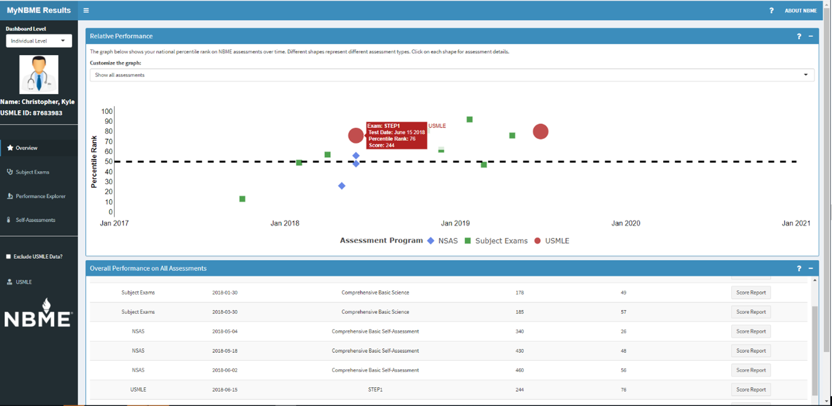
Advancing Assessment in Medical Education
Thursday, June 3 - Francis O’Donnell - 24:15

Slide 40
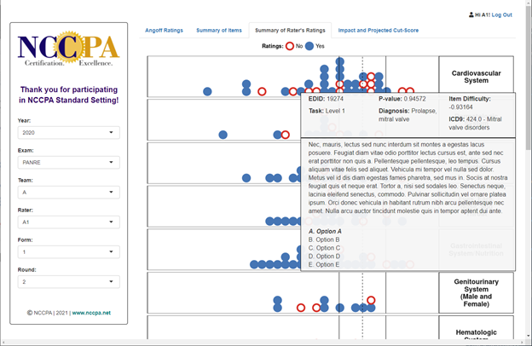

Slide 41
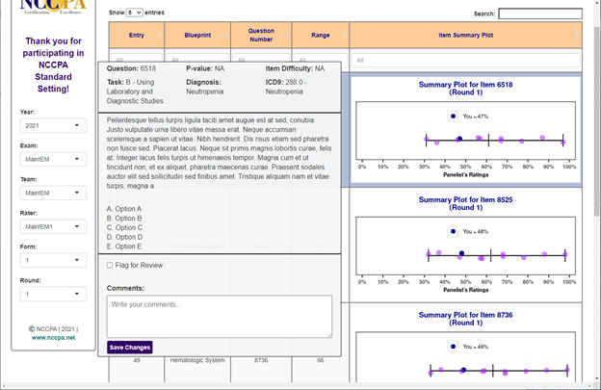

Slide 42
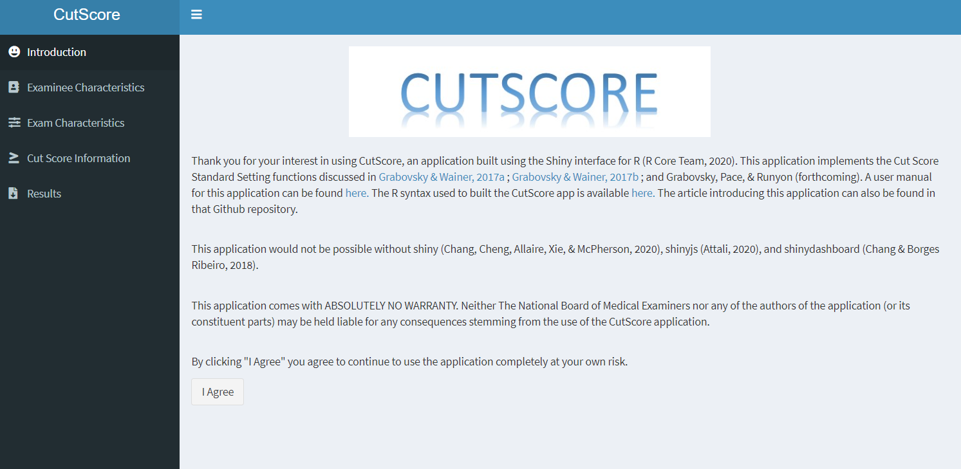
https://cutscore.shinyapps.io/cutscore/

Slide 43
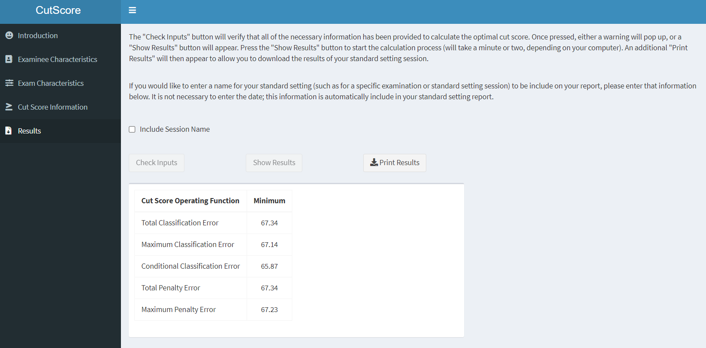

Slide 44
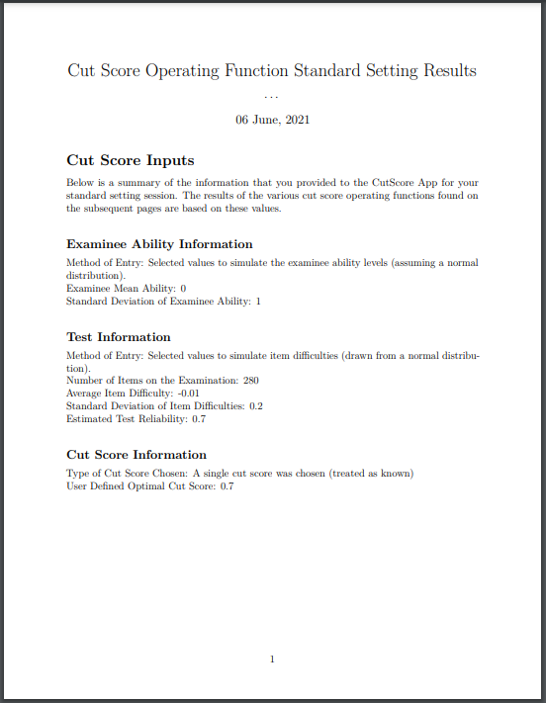
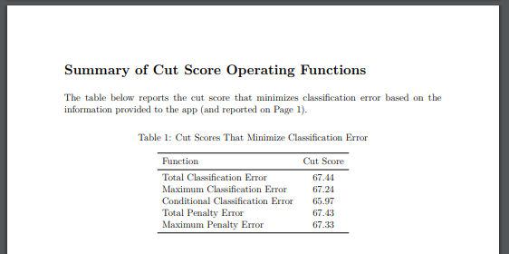
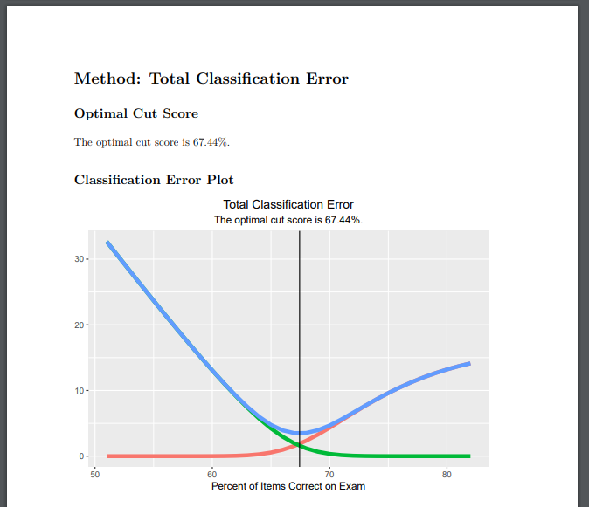

Slide 45
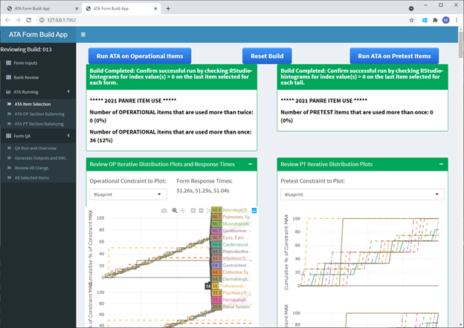

Slide 46
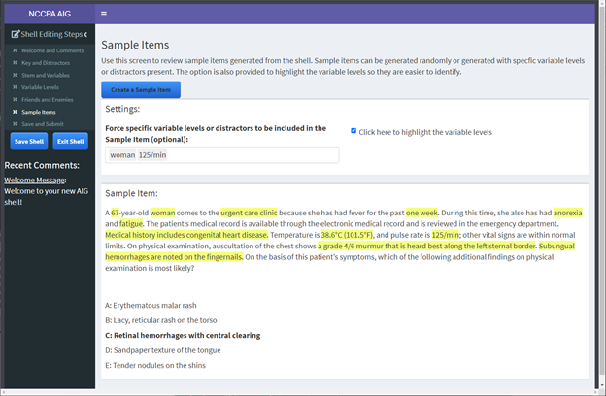

Slide 47
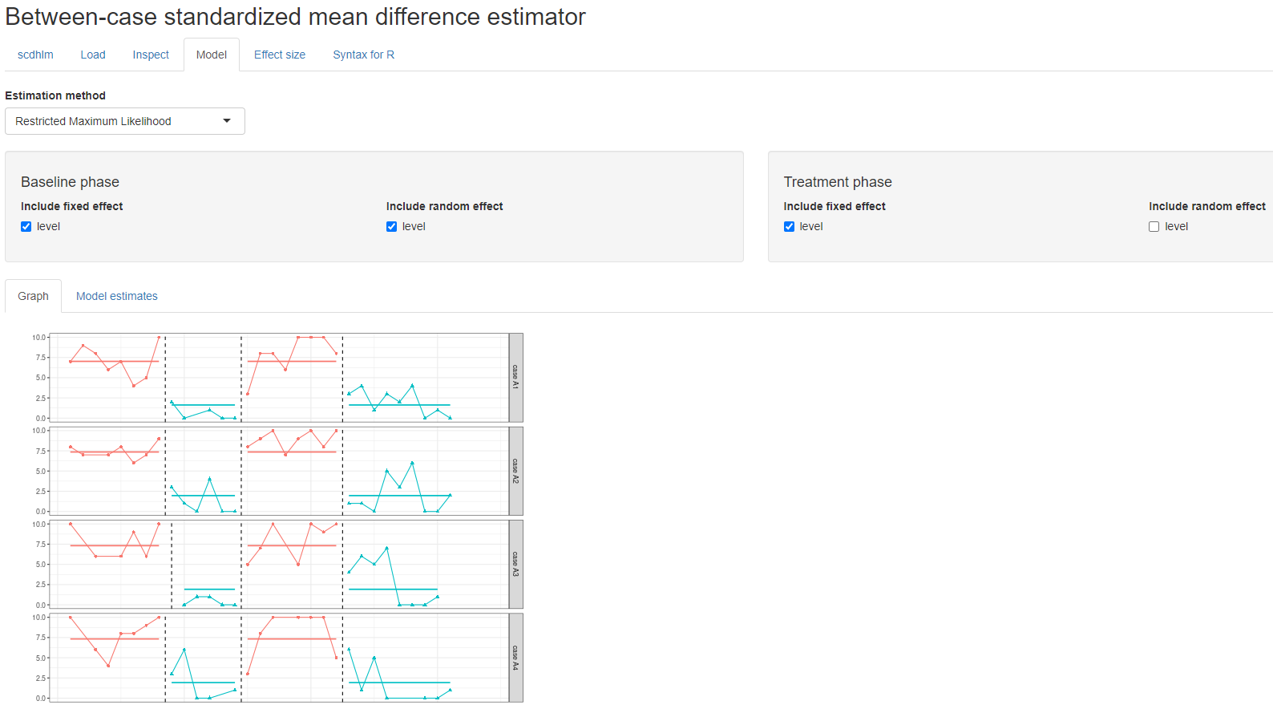
https://jepusto.shinyapps.io/scdhlm

Slide 48
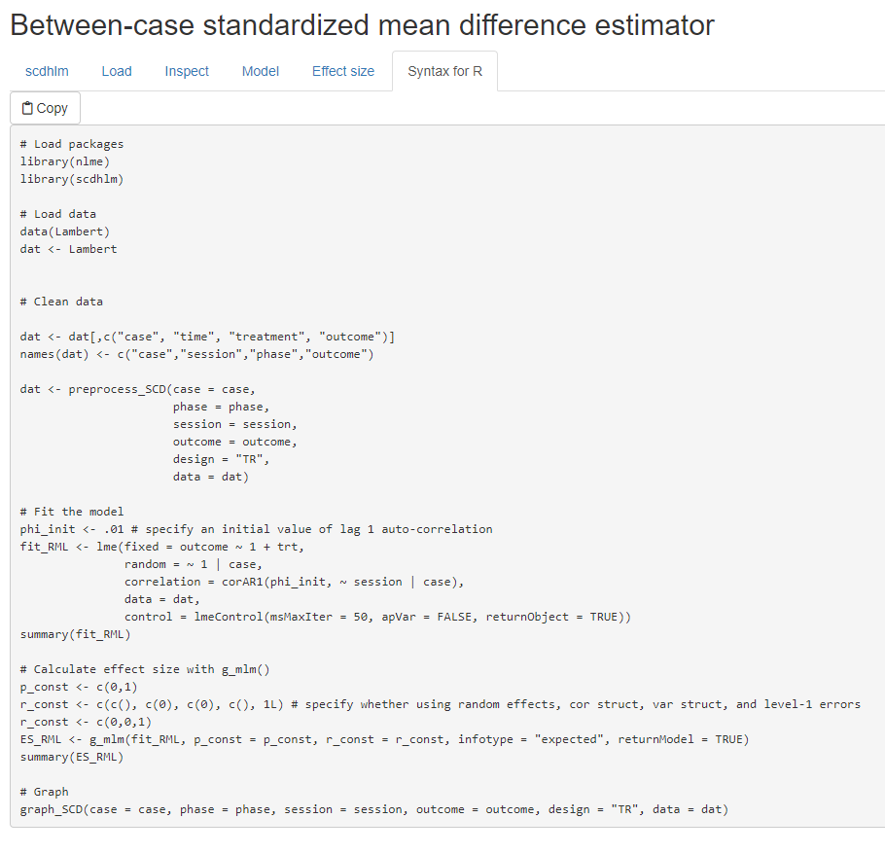

Slide 49
First Shiny Contest Winners
iSEE
69 Love Songs
Hex Memory Game
Pet Records

Slide 50
Second Shiny Contest Winners
GitDiscoverer
Shiny Decisions
Hexmaker
Dean Attali Portfolio (shinyjs author)

Slide 51
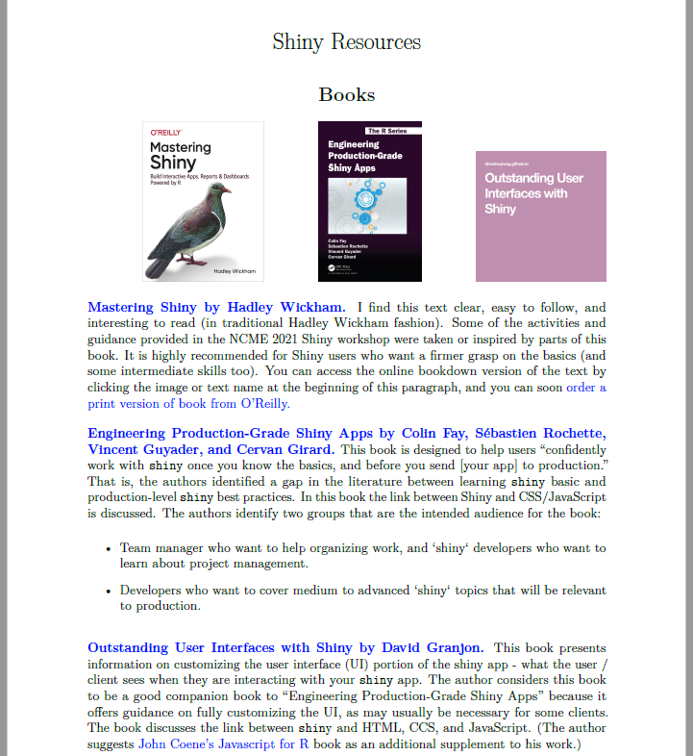
Additional Shiny Resources

Slide 52

Awesome Shiny Extensions (Curated List 1)

Slide 53

Awesome Shiny (Curated List 2)

Slide 54
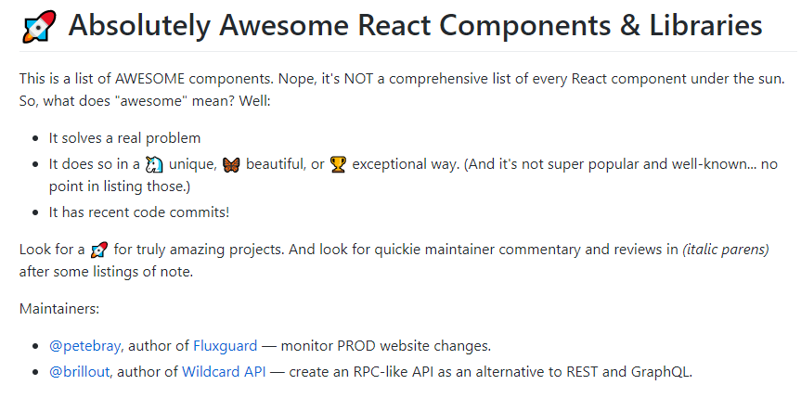
Awesome React Components (Curated List 3)

